Slide 1
Madison v. Alabama
Memory, competency, and impact litigation

Slide 2
background

Slide 3
The eighth amendment
Excessive bail shall not be required, nor excessive fines imposed, nor cruel and unusual punishments inflicted.

Slide 4
The death penalty
Furman v. Georgia, 408 U.S. 238 (1972): the death penalty constitutes cruel and unusual punishment.
Post-Furman backlash: states reintroduce death penalty with bifurcated sentencing process
Gregg v. Georgia, 428 U.S. 153 (1976): the death penalty, imposed via a bifurcated sentencing process, is constitutional
Two rationales: retribution and deterrence

Slide 5
Competency to be executed
Ford v. Wainwright, 477 U.S. 399 (1986) (plurality)
The Eighth Amendment prohibits executing a prisoner who is “insane”
Prisoners who allege incompetency are entitled to a competency evaluation and an evidentiary hearing on the question of their competency to be executed
“one whose mental illness prevents him from comprehending the reasons for the penalty or its implications”
Panetti v. Quarterman, 551 U.S. 930 (2007)
“[A] prisoner is [not] automatically foreclosed from demonstrating incompetency once a court has found he can identify the stated reason for his execution. A prisoner’s awareness of the State’s rationale for an execution is not the same as a rational understanding of it.”
Notes:
In Panetti Justice Kennedy (majority) explicitly states that the court is not setting down a rule governing all competency determinations.

Slide 6
Vernon Madison
Vascular dementia caused by a series of strokes
Significant brain damage: slurred speaking, legally blind, unable to walk independently, urinary incontinence
Petitioner’s Brief: Cannot independently recall the facts of the offense, the sequence of events that led to his sentence, or the name of the victim.
Respondent’s Brief: Able to “understand the nature of the pending proceeding”; understands that the “reason he was in prison is because of ‘murder’” and understands that the State is “seeking retribution” for that crime.

Slide 7
Questions presented
I. Consistent with the Eighth Amendment, and this Court’s decisions in Ford v. Wainwright, 477 U.S. 399 (1986), and Panetti v. Quarterman, 551 U.S. 930 (2007), may the State execute a prisoner whose mental disability leaves him without memory of his commission of the capital offense?
II. Do evolving standards of decency and the Eighth Amendment’s prohibition of cruel and unusual punishment bar the execution of a prisoner whose competency has been compromised by vascular dementia and multiple strokes causing severe cognitive dysfunction and a degenerative medical condition which prevents him from remembering the crime for which he was convicted or understanding the circumstances of his scheduled execution?

Slide 8
arguments

Slide 9
Petitioner
respondent
Memory loss/amnesia alone is not enough
Here, Madison’s dementia provides a necessary plus factor
“Where someone has a disability that renders them incapable of orienting to time or place or rationally understanding the circumstances of their offense, they are incompetent.”
Madison does not meet the Ford/Panetti standard
Madison knows the meaning of a death sentence, and he knows that he is in prison because of murder
Competency to stand trial and competency to waive appeals are the same framework as competency to be executed: rational understanding

Slide 10
impact

Slide 11
An aging death row population
Bryan Stevenson (counsel for petitioner): “I don’t think the age of the offender is a predictor of the scale of this phenomena . . . Mr. Madison’s problems are cerebrovascular, which, of course, can happen at any age.”
In 2007, 5.8% of death row prisoners were over 60
In 2013, 12.2% of death row prisoners were over 60
Between 1977 and 1999, 10 prisoners executed were over 60
Between 2008 and 2018, 36 prisoners executed were over 60; 13 since 2015 alone
Notes:
As mentioned in the First Mondays podcast, it’s interesting to think about the broader strategy behind this litigation
The death penalty has been chipped away at over the last few decades, and the aging population of death row may provide another opportunity to limit its reach.

Slide 12
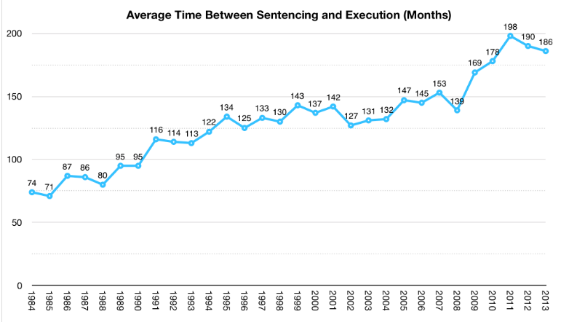

Slide 13
Age at Time of execution: over 50 vs. under 50

Slide 14
prediction

Slide 15
Notes from the justices
Sotomayor: “How would I define severe dementia? What’s the difference between mild, moderate, and severe dementia?” “I am worried about something like Alzheimer’s.”
Worried about slippery slope/floodgates
Alito: “The events concerning Kirkwood.”
Note Kirkwood’s disqualification from the profession
Breyer: “If two things are true; one, he does not recall his crime; and second, he has a severe inability to orient himself to time or place . . . Would you accept the fact that such a person cannot be executed under the Eighth Amendment?”
A potential addition to the Ford/Panetti framework
Roberts: “There are two questions. You concede on one, and the state concedes on the other.”
Petitioner concedes that memory loss alone is not enough
Respondent concedes that the Ford/Panetti standard may be satisfied by vascular dementia...just not in this case

Slide 16
Roberts?
For petitioner:
Ginsburg
Breyer
Sotomayor
Kagan
For respondent:
Thomas
Alito
Gorsuch
Notes:
Kavanaugh was not yet confirmed when this case was argued
A 4-4 split would leave in place the determination of the lower court—Madison will be executed

