Slide 1
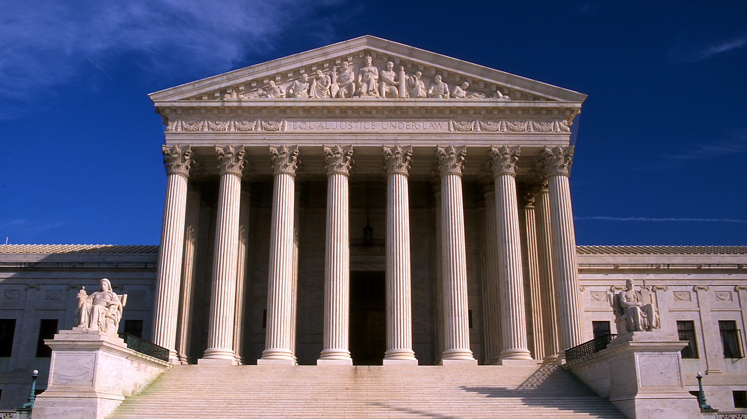
Currier v. Virginia
Vince dutkowski

Slide 2
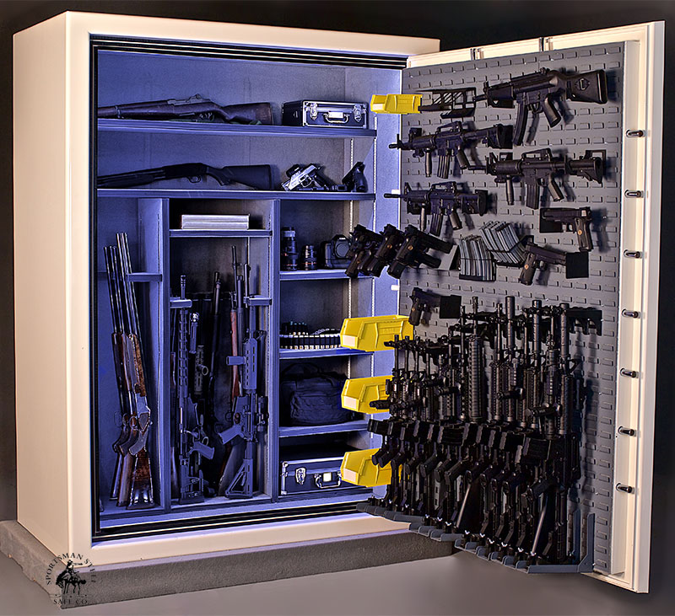
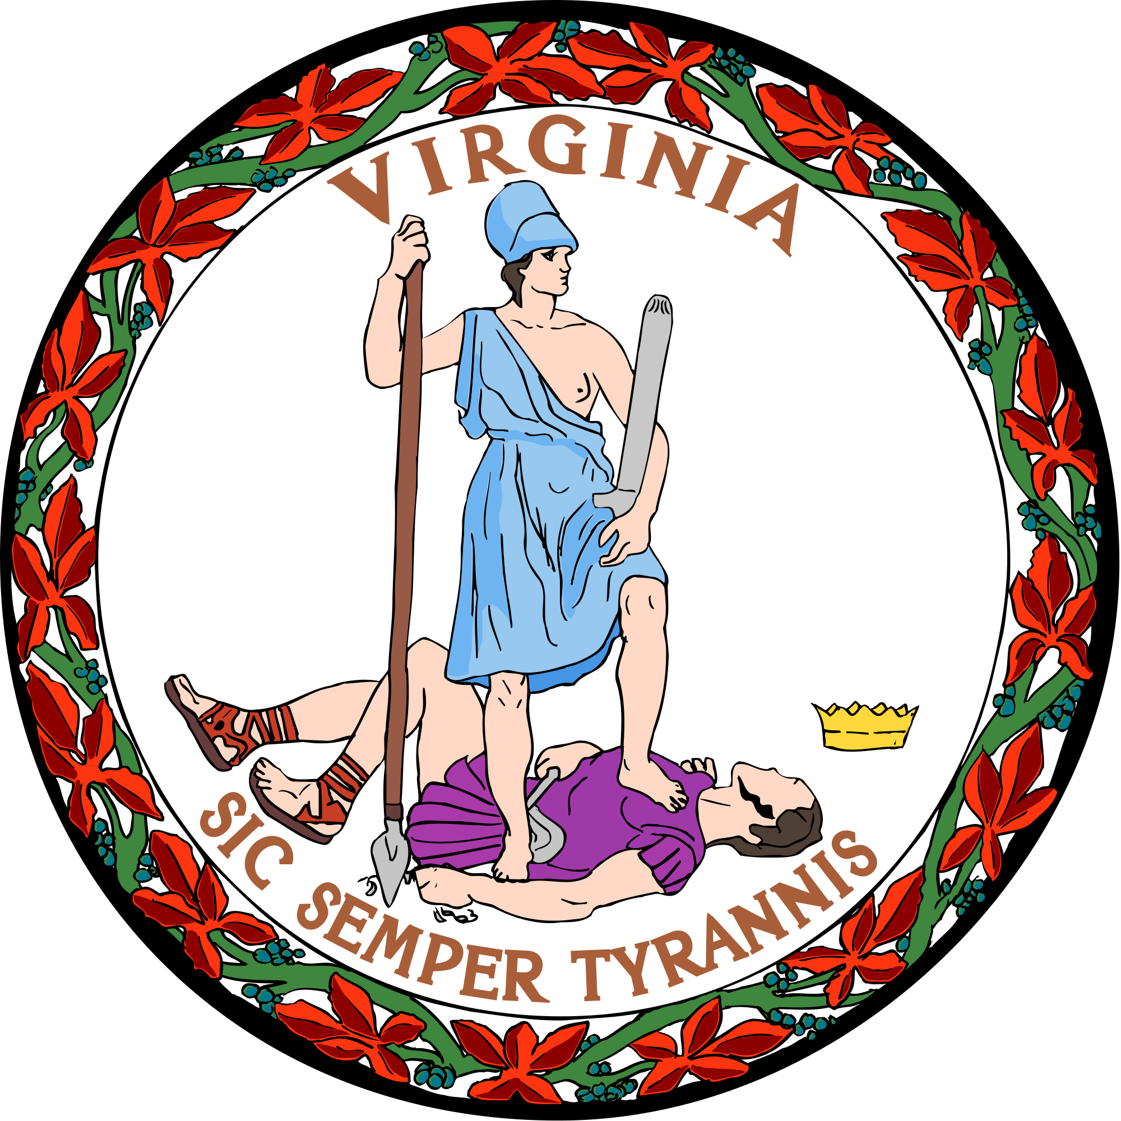
Background
Details of the crime
Evidence against Currier
Currier’s prior criminal conviction
Hackney v. Commonwealth - Severance of the felon in possession charge
Two trials:
The first involving a breaking and entering and grand larceny
The second involving a felon in possession of a firearm.

Slide 3
Why sever the trials?
Virginia court rules require any felon in possession charge to be severed before trial, unless the parties agree to joinder
Evidence of prior felonies is prejudicial against defendants
Defendant agreed to have the trial severed here (Justice Sotomayor questioned the nature of the “agreement”)
Did consent to sever the trials constitute a waiver of issue-preclusive rights?

Slide 4
Trial results
Currier was acquitted of both charges in the first trial
The Commonwealth then sought to try Currier on the felon in possession charge
Currier objected, argued that retrial was precluded, or at least that the Commonwealth was barred from using evidence of involvement in the theft and burglary
Currier was convicted and sentenced to five years in prison, Court of Appeals affirmed

Slide 5
Issue:
Whether a defendant who has consented to the severance of multiple charges into sequential trials loses his or her right to the issue-preclusive effect of the Double Jeopardy Clause of an acquittal.

Slide 6
Overview of cases

Slide 7
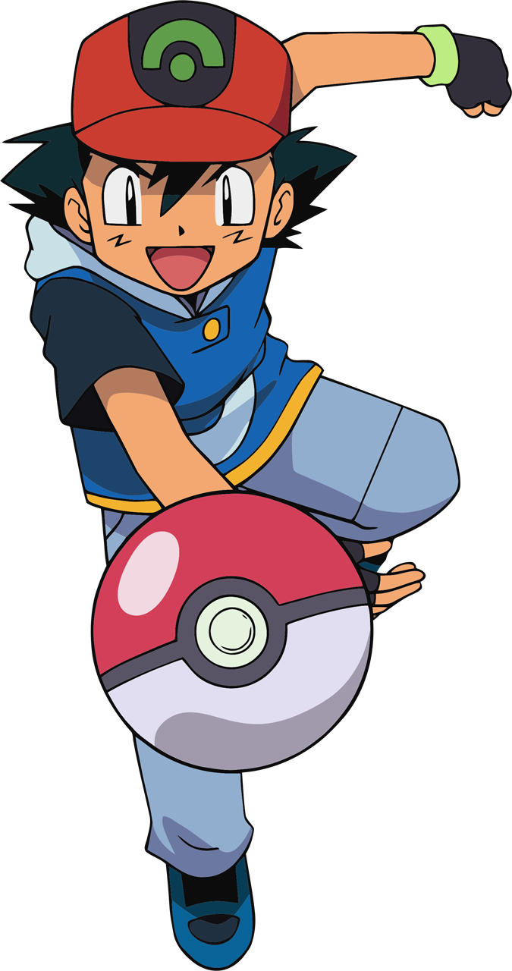
Ashe v. Swenson (1970)

Slide 8
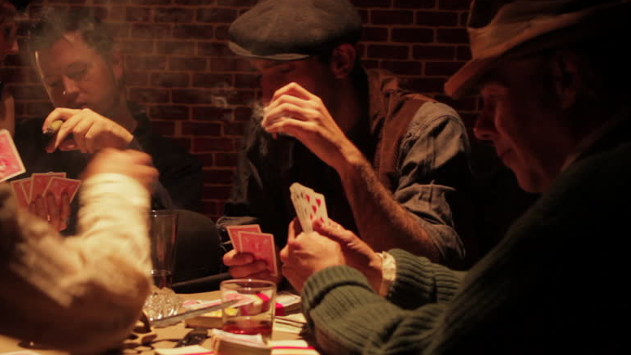
Ashe v. Swenson (1970)
Defendant was arrested for allegedly robbing six men that were playing poker
He was found not guilty of robbing one of the individuals due to insufficient evidence.
Prosecution then sought to bring a charge for the robbery of one of the other individuals
Supreme Court held that “when an issue of ultimate fact has once been determined by a valid and final judgment, that issue cannot again be litigated between the same parties in any future lawsuit.”

Slide 9
Ashe v. Swenson
Currier’s argument:
Virginia is using the same facts.
The jury concluded Ashe wasn’t guilty of
the crime, his alibi was that he wasn’t there
He was only alleged to have handled and possessed the guns in the course of the robbery.
Virginia’s argument:
This isn’t the point of Double Jeopardy clause
This isn’t “unfair and abusive reprosecution”
These charges were brought by a single grand jury and the felon in possession charge was severed for the benefit of the Defendant

Slide 10
Jeffers v. United States (1977)
Defendant was charged with two indictments.
1. Conspiring to distribute heroin and cocaine
2. Conducting a continuing criminal enterprise to violate the drug laws
Found guilty of the distribution charge. Then found guilty of the second (more severe) offense and given life imprisonment after Motion to Dismiss was denied.
Court held that Petitioner’s action in opposing the Government’s motion to consolidate the indictments stripped him of his right against consecutive trials and affirmed the sentencing.
Currier: Prosecution gets one shot to prove all of its allegations. No acquittal here, only a conviction.
Virginia: Defendant asked for two trials, then he wanted one trial. That’s what Currier is doing here.

Slide 11
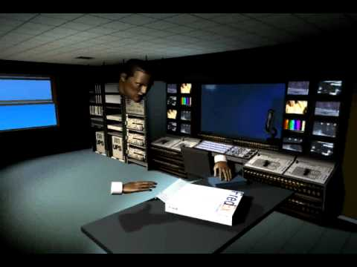
Yeager v. United States (2009)
A jury acquitted defendant of conspiracy, wire fraud, and securities fraud, but was hung on 20 counts of insider trading and 99 counts of money laundering.
Does the Double Jeopardy Clause bar retrial when a jury acquits a defendant on some counts, but fails to reach a verdict on other counts whose essential elements must have been decided in the defendant's favor by a rational jury?
Held: Yes.
6-3 decision. Chief Justice Roberts joined the majority and Justice Kennedy issued a concurrence.

Slide 12
Summarizing arguments for Currier
His consent wasn’t express consent and he was forced to consent to not have a prejudicial trial
Acquittals are especially important, we need to respect the jury’s decisions
This isn’t going to preclude all future trials
If you decide against us, U.S. v. Wittig is wrong (wink wink, Justice Gorsuch)

Slide 13
Summarizing arguments for Virginia
Currier consented to severing the trials and it was done for his benefit, and therefore constituted a waiver of his right to issue preclusion
If the Court finds no waiver, Currier would need to carry his burden of showing an issue of ultimate fact was decided
If you don’t rule for us, prosecutors are going to be incentivized to oppose severance (wink wink, Justice Kennedy and Justice Breyer)
This isn’t the interest Double Jeopardy and issue preclusion aim to protect

Slide 14
Reactions from the Justices

Slide 15
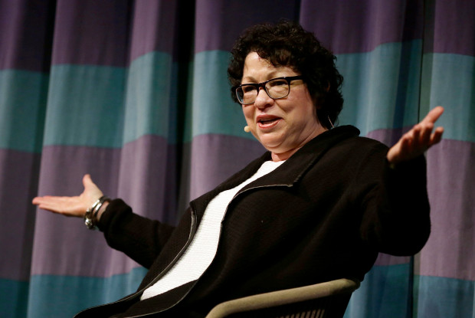
Justice Sotomayor
“How can you call this an agreement? State law says you're entitled to severance unless both of you consent to joinder. So, under state law, they have an absolute right to severance.
So they're agreeing to what the law gives them?”

Slide 16
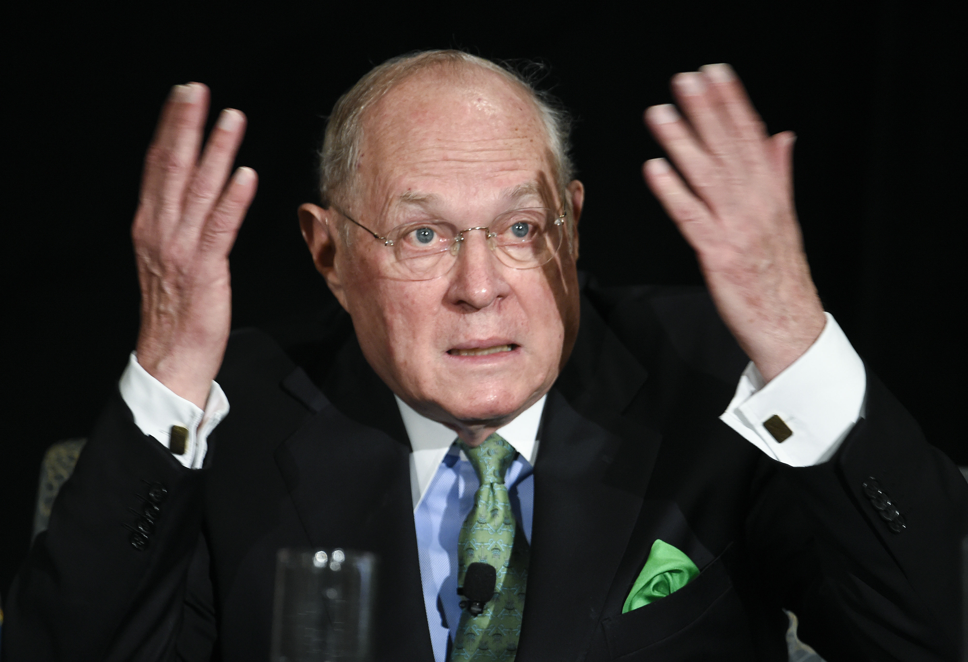
Justice Kennedy
“doesn't that really set up a waiver? Isn't that something like a waiver if he doesn't agree?”
- under Hackney, a defendant and prosecutor must sever a felon in possession charge unless the two sides agree to joinder
“Suppose you prevail in this case. Would a state then say, okay, what we'll do is we'll just try . . . both of them together, and the jury will hear all the evidence about the felony. . . are you happy with what you wish for here?”

Slide 17
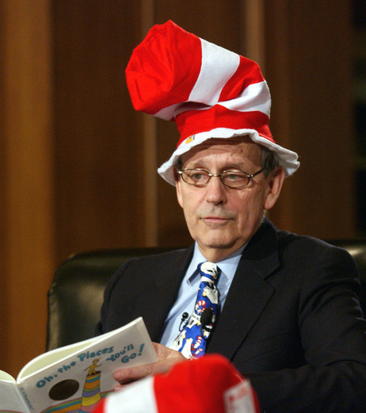
Justice Breyer
“It’s complicated.”

Slide 18
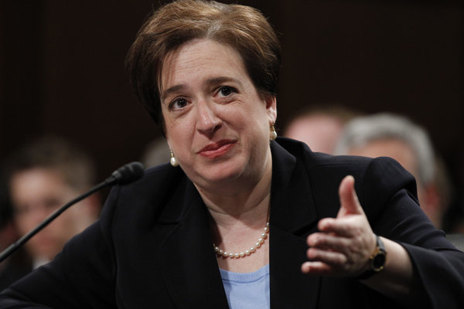
Justice Kagan
“if the way to think about this case is what is the defendant giving up when he agrees to a severance, then the obvious answer is: Tell the defendant what the consequences are, and ask him whether he's willing to suffer them.”

Slide 19
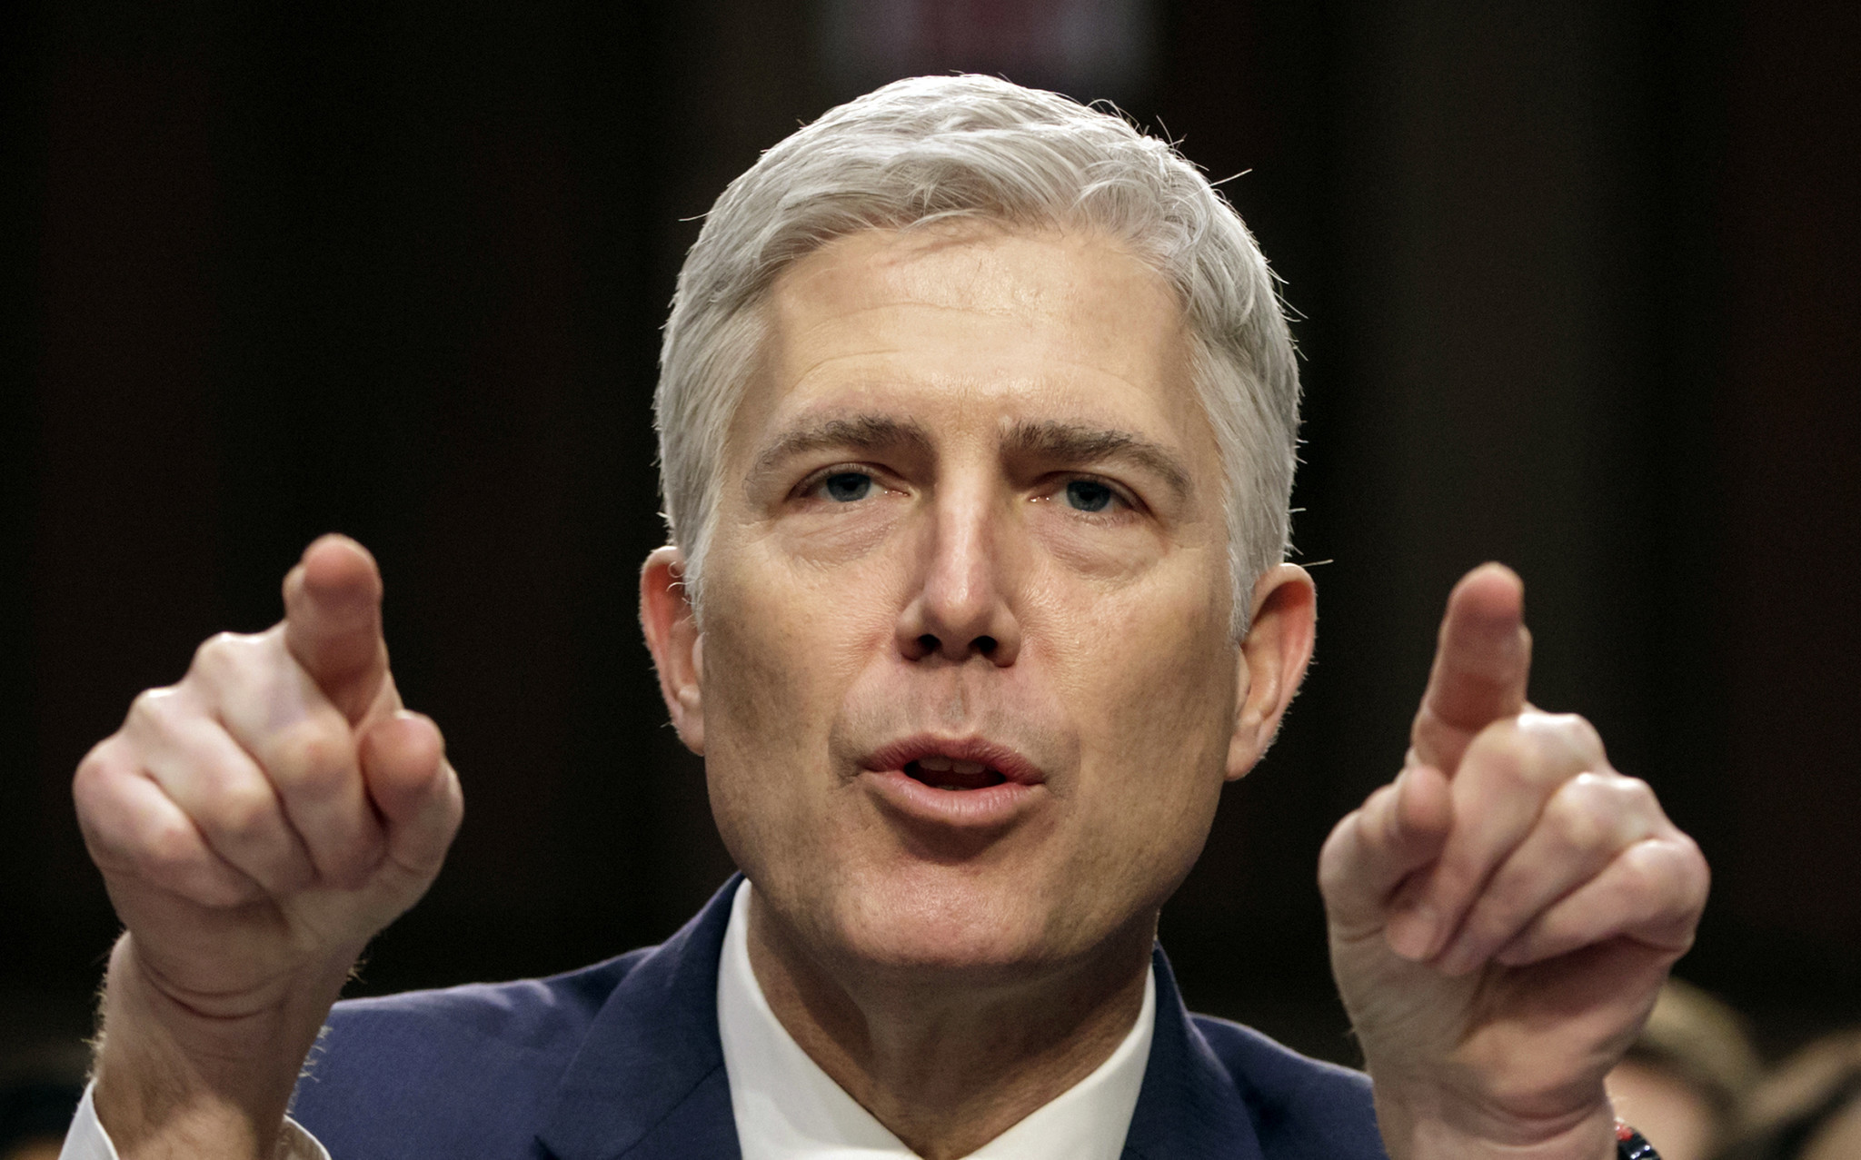
Justice Gorsuch
“We shouldn't be concerned that it's anomalous that it would be creating. . . an issue preclusion doctrine that may be more robust than in the civil context here, even though in claim preclusion it's less robust?” – Justice Gorsuch

Slide 20
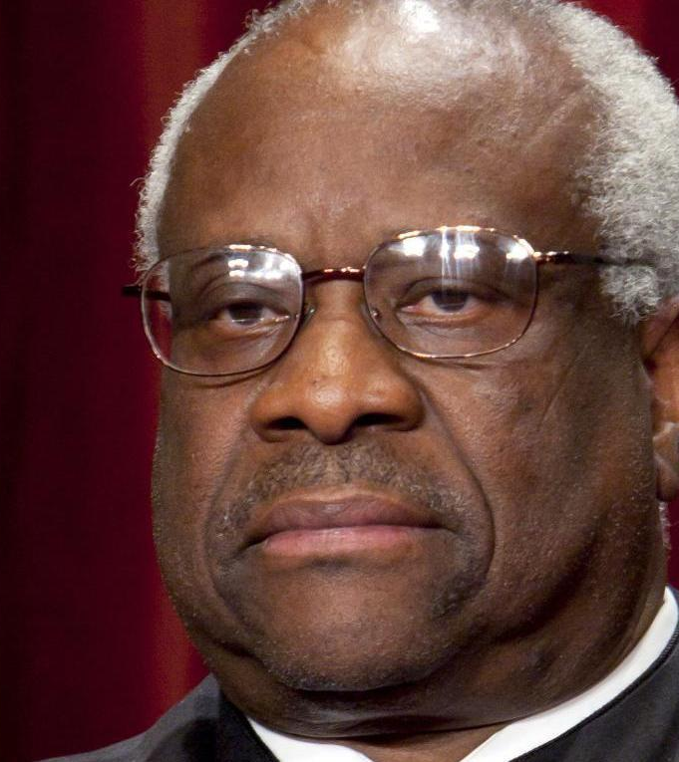
Justice Thomas
“…”

Slide 21
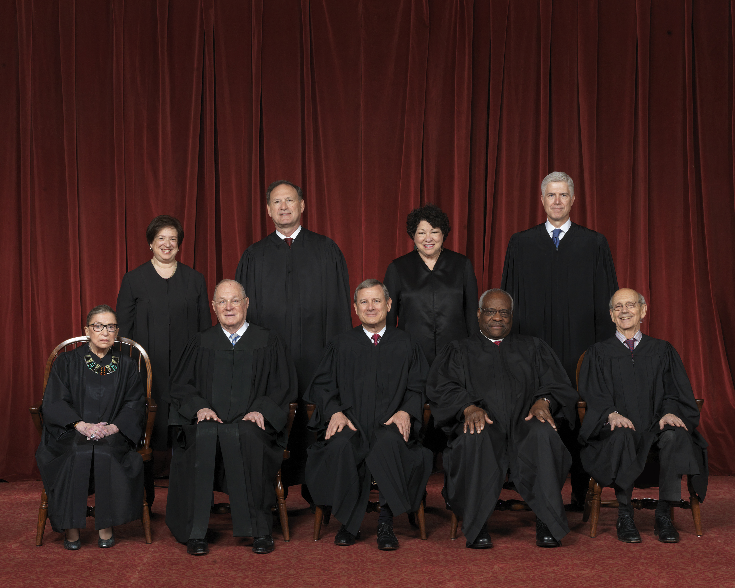
Predictions

Slide 22
Predictions
The Court will affirm in favor of Virginia.
The conservative justices and Justice Kennedy will side with Virginia.
There might even be some support from liberal justices, possibly from Justice Breyer or Justice Kagan.
For Currier to win, he might need Justice Gorsuch to buy into the idea that his old ruling is being reversed or get Chief Justice Roberts to side with him.

