Slide 1
Contemporary Supreme Court Cases
Spring 2018
MC381
Tonja Jacobi
LM207
t-jacobi@law. northwestern.edu
or drtonja@gmail.com
Abby Mollen
abby.mollen@law. northwestern.edu
First Class:
Administration & Introduction

Slide 2
Today’s Agenda
Focus of the class
Assessment & responsibilities
Choosing cases
Assigning cases
The Supreme Court's internal workings
Introduction to the literature
The role of oral arguments
​

Slide 3
Focus & Assessment
Focus:
Supreme Court agenda
Judicial politics & behavior
Advocacy
Assessment:
Paper on #1 or #2 or #3 – or by agreement
Class participation
Class organization & presentation
Responsibilities for (c):
10 minute talk: no summaries
Email links to both oral arguments, deal with any problems
3 interesting short articles/blogs/podcasts * Useful websites: oyez.org, Scotusblog.com, Supremecourt.gov, newrepublic.com, fed-soc.org, volokh.com, atlantic.com, newyorker.com
Cases: list = default…

Slide 4
Proposed Schedule
January 9 — Administration and Introduction January 16 — Partisan Gerrymandering & Fourth Amendment Partisan Gerrymandering: Gill v. Whitford, [Arg: 10.3.2017] Fourth Amendment: District of Columbia v. Wesby, [Arg: 10.4.2017] January 23 — Criminal Procedure & Employment Criminal Procedure: Class v. United States, [Arg: 10.4.2017] Employment: Ernst & Young LLP v. Morris, [Arg: 10.2.2017] January 30 — Separation of Powers & Fourth Amendment Separation of Powers: Patchak v. Zinke, [Arg: 11.7.2017] Fourth Amendment: Carpenter v. United States, [Arg: 11.29.2017] February 6 — Immigration & Federalism Immigration: Jennings v. Rodriguez, [Arg: 10.3.2017] Federalism: Christie v. NCAA, [Arg: 12.4.2017] February 13 — First Amendment & Water Rights First Amendment: Masterpiece Cakeshop, Ltd. v. Colorado Civil Rights Commission, [Arg: 12.5.2017] Water Rights: Florida v. Georgia, [Arg. 1.8.2018] or Texas v. New Mexico and Colorado, [Arg. 1.8.2018] February 20 — Voter Registration & Fourth Amendment Voter Registration: Husted v. A. Philip Randolph Inst. [Arg: 1.8.2018] Fourth Amendment: Collins v. Virginia, [Arg. 1.9.2018] | February 27 — Fourth Amendment & Separation of Powers/Seventh Amendment Fourth Amendment: Byrd v. United States [Arg. 1.9.2017] Separation of Powers/Seventh Amendment: Oil States Energy Services v. Greene’s Energy Group, [Arg: 11.27.2017] March 6 — Fifth Amendment & Double Jeopardy Fifth Amendment: City of Hays v. Vogt, [Arg: 2.20.2018] Double Jeopardy: Currier v. Virginia, [Arg: 2.20.2018] March 13 — Plain Error Review & First Amendment/Union Dues Plain Error: Rosales-Mireles v. United States, [Arg. 2.21.2018] First Amendment/Union Dues: Janus v. Am. Fed’n of State, County & Municipal Employees, Council 31, [Arg. 2.26.2018] March 22 — no class, spring break March 20 — Antitrust & Privacy Antitrust: Ohio v. American Express, [Arg. 2.26.2018] Privacy: United States v. Microsoft Corp., [Arg. 2.27.2018] March 27 — No Class – Spring Break April 3 — First Amendment x 2 First Amendment (retaliation): Lozman v. City of Riviera Beach, Florida, [Arg. 2.27.2018] First Amendment (polling place restrictions): Minnesota Voters Alliance v. Mansky, [Arg. 2.28.2018] April 10 — TBD
New cases or others of interest?...
Notes:
Cases Not Yet Set for Argument

Slide 5
New cases or others of interest
Dahda v. United States, No. 17-43, [Arg. 2.21.2018]
Issue: Whether Title III of the Omnibus Crime Control and Safe Streets Act of 1968, 18 U.S.C. §§ 2510–2520, requires suppression of evidence obtained pursuant to a wiretap order that is facially insufficient because the order exceeds the judge's territorial jurisdiction.
National Institute of Family and Life Advocates v. Becerra, No. 16-1140
Issue: Whether the disclosures required by the California Reproductive FACT Act violate the protections set forth in the free speech clause of the First Amendment, applicable to the states through the 14th Amendment.
Benisek v. Lamone, No. 17-333
(1) Whether the majority of the three-judge district court erred in holding that, to establish an actual, concrete injury in a First Amendment retaliation challenge to a partisan gerrymander, a plaintiff must prove that the gerrymander has dictated and will continue to dictate the outcome of every election held in the district under the gerrymandered map; (2) whether the majority erred in holding that the Mt. Healthy City Board of Education v. Doyle burden-shifting framework is inapplicable to First Amendment retaliation challenges to partisan gerrymanders; and (3) whether, regardless of the applicable legal standards, the majority erred in holding that the present record does not permit a finding that the 2011 gerrymander was a but-for cause of the Democratic victories in the district in 2012, 2014, or 2016.

Slide 6
Additional cases?

Slide 7
The Supreme Court’s inner workings

Slide 8
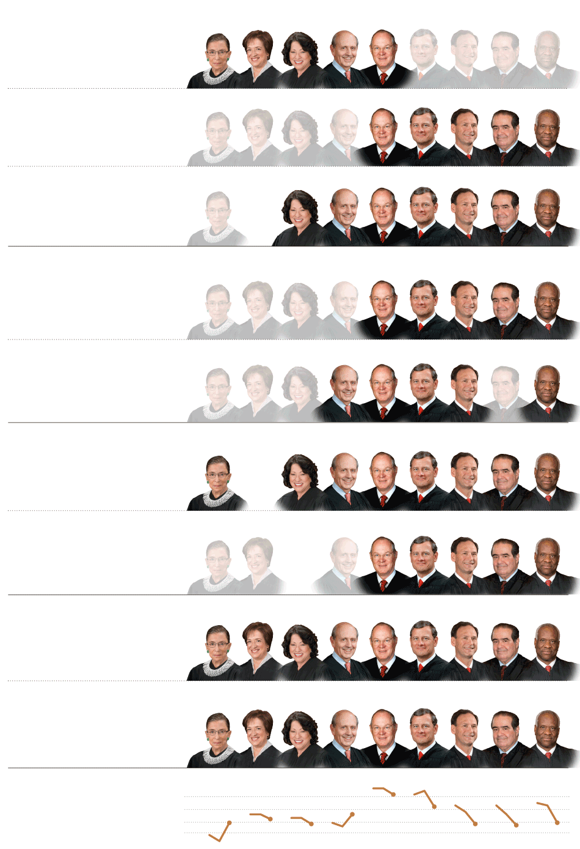
EQUALITY
United States v. Windsor 5-4
The court struck down the part of the Defense of Marriage Act that
denied federal benefits to married same-sex couples.
Shelby County v. Holder 5-4
The court effectively struck down part of the Voting Rights Act of 1965
Subjecting states with a history of discrimination to federal oversight.
Fisher v. Texas 7-1
The court let stand a race-conscious admissions program at the University
of Texas but told a lower court to reconsider its constitutionality.
PRIVACY
Clapper v. Amnesty International 5-4
The court ruled that human rights groups, reporters and lawyers had
no standing to challenge a government surveillance program.
Maryland v. King 5-4
The court ruled that the police may collect DNA samples from arrestees.
BUSINESS
Kiobel v. Royal Dutch Petroleum 9-0
The court limited lawsuits against corporations for human rights abuses abroad.
American Express v. Italian Colors 5-3
The court ruled that companies can avoid class actions through
arbitration agreements.
PATENTS
Bowman v. Monsanto 9-0
The court ruled that a farmer violated patent laws by saving seeds
from genetically modified soybeans.
Association for Molecular Pathology 9-0
v. Myriad Genetics
The court ruled that isolated human genes may not be patented.

Slide 9
Judicial Voting Behavior
The first Roberts Court in one dimension
The second Roberts Court in one dimension
*See:
Supreme Court database: scdb.wustl.edu/
Martin & Quinn: http://mqscores.wustl.edu/
Bailey & Chang: http://www9.georgetown.edu/ faculty/baileyma/ajps_offprint_bailey.pdf
Judicial common space scores: 23 JLEO 303 (2007)

Slide 10
Judicial drift?

Slide 11
Fischman & Jacobi: 2D
The first Roberts Court in two dimensions
The second Roberts Court in two dimensions

Slide 12
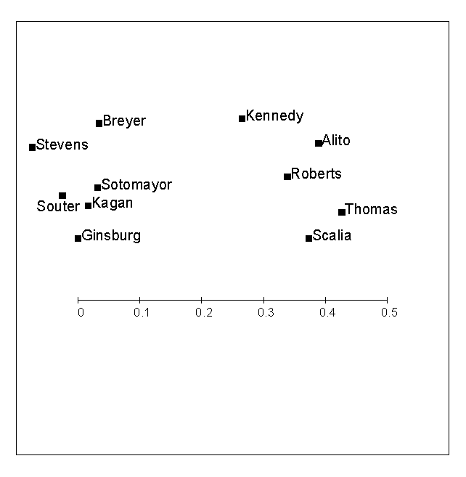
Roberts Court altogether

Slide 13
“Legalism” and “Pragmatism”
Legalism | Pragmatism
Categorical application of rules | Balancing multiple interests
Interpret rules broadly, few exceptions | Particularistic approach, more exceptions
More concern about conformity with legal sources (statutory text and/or purpose) | More concern about policy consequences
Maximalism – create new doctrine in the form of broad rules | Minimalism – narrow holdings, limited to facts of case
Notes:
Crude categories
Not a strict dichotomy – tension between some of these descriptions
Maybe not the best terms
distinction really 60/40 – not a cartoonish version

Slide 14
Other Issues
Case choice
Selection bias
“Boring cases”
Avoidance
Judicial “self-restraint”
The role of advocacy
Other dimensions:
Judicial methodology
Federalism
Minimalism
Idiosyncratic preferences

Slide 15
Do Oral Arguments Matter?
Questions:
What makes a good advocate?
Can Blackmun’s grades plausibly be seen as measuring the quality of the case versus the performance of the advocate?
The big question: do oral arguments matter?
The interplay between quality and ideology…
Timothy R Johnson, Paul J Wahlbeck & James F Spriggs, II, The Influence of Oral Arguments on the U.S. Supreme Court, American Political Science Review, Vol. 100, No. 1, (2006)

Slide 16
Ideology vs Quality

Slide 17
Relative Impact

Slide 18
Next week
January 16 — Partisan Gerrymandering & Fourth Amendment
Partisan Gerrymandering: Gill v. Whitford
Fourth Amendment: District of Columbia v. Wesby

