Slide 1
Contemporary Supreme Court Cases
Spring 2017
MC375
Tonja Jacobi
LM207
t-jacobi@law. northwestern.edu
First Class:
Administration & Introduction

Slide 2
Today’s Agenda
Focus of the class
Assessment & responsibilities
Choosing cases
Assigning cases
Introduction to the literature
The role of oral arguments

Slide 3
Focus & Assessment
Focus:
Supreme Court agenda
Judicial politics & behavior
Advocacy
Assessment:
Paper on #1 or #2 or #3 – or by agreement
Class participation
Class organization & presentation
Responsibilities for (c):
10 minute talk: no summaries
Email links to both oral arguments, deal with any problems
3 interesting short articles/blogs/podcasts * Useful websites: oyez.org, Scotusblog.com, Supremecourt.gov, newrepublic.com, fed-soc.org, volokh.com, atlantic.com, newyorker.com
Cases: list = default…

Slide 4
Proposed Schedule
January 11 — Administration and Introduction January 18 — Fourth Amendment & Fifth Amendment Fourth Amendment: Manuel v. City of Joliet, [Arg: 10.5.2016] Fifth Amendment: Buck v. Davis, [Arg: 10.5.2016] January 25 — Copyright & Civil procedure and the ADA Copyright: Pena-Rodriguez v. Colorado, [Arg: 10.11.2016] Civil procedure: Fry v. Napoleon Community Schools, [Arg: 10.31.2016] February 1 — Presidential power & Federal jurisdiction Presidential power: NLRB v. SW General, [Arg: 11.7.2016] Federal Jurisdiction: Lightfoot v. Cendant Mortgage Co., [Arg: 11.8.2016] February 8 — Equal Protection+ immigration & Death penalty Equal protection: Lynch v. Morales-Santana, [Arg: 11.9.2016] Death penalty: Moore v. Texas, [Arg: 11.29.2016] February 15 — Racial gerrymandering x2 McCrory v. Harris, [Arg: 12.5.2016] Bethune-Hill v. Virginia State Board of Elections, [Arg: 12.5.2016] February 22 — Immigration + detention & Tribal sovereignty Immigration & detention: Jennings v. Rodriguez, [Arg: 11.30.2016] Tribal sovereignty: Lewis v. Clarke, [Arg: 1.9.2017] | March 1 — Due Process & Commercial free speech Due process: Nelson v. Colorado, [Arg: 1.9.2017] Free speech: Expressions Hair Design v. Schneiderman, [Arg: 1.10.2017] March 8 — Immunity from suit & Trademark Immunity from suit: Ziglar v. Abbasi, [Arg: 1.18.2017] Trademark: Lee v. Tam, [Arg: 1.18.2017] Cases Not Yet Set for Argument March 15 — Use of deadly force + qualified immunity & Establishment clause Establishment clause: Trinity Lutheran Church of Columbia v. Pauley March 22 — no class, spring break March 29 — Free speech & Brady violations Free speech & sex offenders: Packingham v. North Carolina, Brady violations: Turner v. U.S., No. 15-1503 & Overton v. U.S. April 5 — Transgender rights & Plea bargaining + immigration Transgender rights: Gloucester County School Board v. G.G., Plea-bargaining & immigration: Lee v. U.S. April 12 — Patents + Civil procedure & Police use of force Patents & civil procedure: TC Heartland v. Kraft Foods Group Brands Police use of force: County of Los Angeles v. Mendez
New cases or others of interest?...

Slide 5
New cases or others of interest
Murr v. Wisconsin, No. 15-214 Issue(s): Whether, in a regulatory taking case, the “parcel as a whole” concept as described in Penn Central Transportation Company v. City of New York, establishes a rule that two legally distinct but commonly owned contiguous parcels must be combined for takings analysis purposes.
Microsoft Corp. v. Baker, No. 15-457 Issue(s): Whether a federal court of appeals has jurisdiction to review an order denying class certification after the named plaintiffs voluntarily dismiss their claims with prejudice.
Honeycutt v. U.S., No. 16-142 Issue(s): Whether 21 U.S.C. § 853(a)(1) mandates joint and several liability among co-conspirators for forfeiture of the reasonably foreseeable proceeds of a drug conspiracy.
Others?

Slide 6
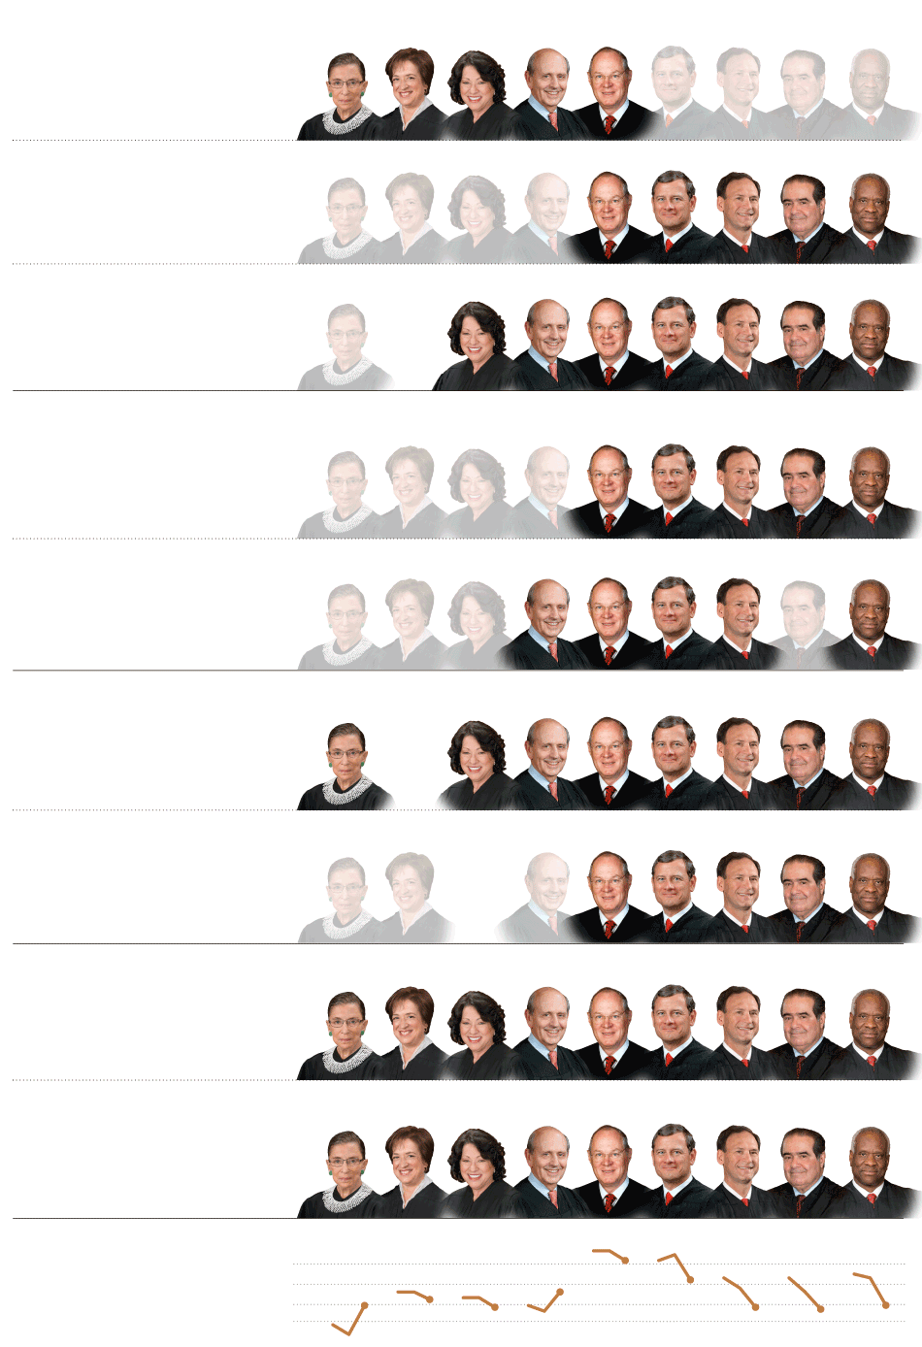
EQUALITY
United States v. Windsor 5-4
The court struck down the part of the Defense of Marriage Act that
denied federal benefits to married same-sex couples.
Shelby County v. Holder 5-4
The court effectively struck down part of the Voting Rights Act of 1965
Subjecting states with a history of discrimination to federal oversight.
Fisher v. Texas 7-1
The court let stand a race-conscious admissions program at the University
of Texas but told a lower court to reconsider its constitutionality.
PRIVACY
Clapper v. Amnesty International 5-4
The court ruled that human rights groups, reporters and lawyers had
no standing to challenge a government surveillance program.
Maryland v. King 5-4
The court ruled that the police may collect DNA samples from arrestees.
BUSINESS
Kiobel v. Royal Dutch Petroleum 9-0
The court limited lawsuits against corporations for human rights abuses abroad.
American Express v. Italian Colors 5-3
The court ruled that companies can avoid class actions through
arbitration agreements.
PATENTS
Bowman v. Monsanto 9-0
The court ruled that a farmer violated patent laws by saving seeds
from genetically modified soybeans.
Association for Molecular Pathology 9-0
v. Myriad Genetics
The court ruled that isolated human genes may not be patented.

Slide 7
Judicial Voting Behavior
The first Roberts Court in one dimension
The second Roberts Court in one dimension
*See:
Supreme Court database: scdb.wustl.edu/
Martin & Quinn: http://mqscores.wustl.edu/
Bailey & Chang: http://www9.georgetown.edu/ faculty/baileyma/ajps_offprint_bailey.pdf
Judicial common space scores: 23 JLEO 303 (2007)

Slide 8
Judicial drift?

Slide 9
Fischman & Jacobi: 2D
The first Roberts Court in two dimensions
The second Roberts Court in two dimensions

Slide 10
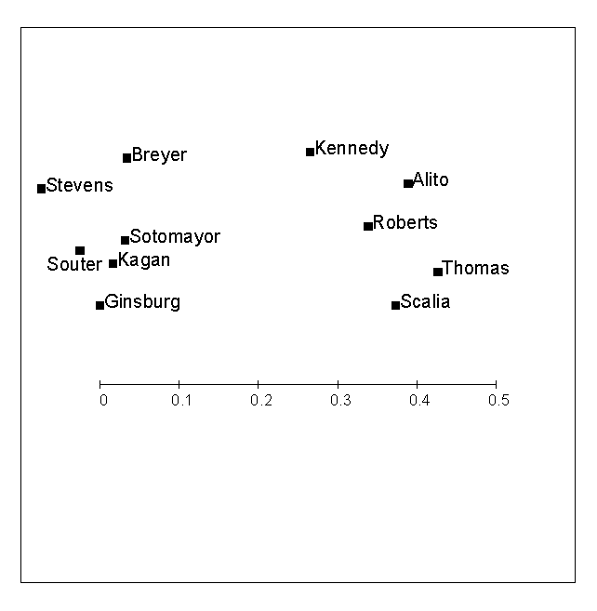
Roberts Court altogether

Slide 11
“Legalism” and “Pragmatism”
Legalism | Pragmatism
Categorical application of rules | Balancing multiple interests
Interpret rules broadly, few exceptions | Particularistic approach, more exceptions
More concern about conformity with legal sources (statutory text and/or purpose) | More concern about policy consequences
Maximalism – create new doctrine in the form of broad rules | Minimalism – narrow holdings, limited to facts of case
Notes:
Crude categories
Not a strict dichotomy – tension between some of these descriptions
Maybe not the best terms
distinction really 60/40 – not a cartoonish version

Slide 12
Other Issues
Case choice
Selection bias
“Boring cases”
Avoidance
Judicial “self-restraint”
The role of advocacy
Other dimensions:
Judicial methodology
Federalism
Minimalism
Idiosyncratic preferences

Slide 13
Do Oral Arguments Matter?
Questions:
What makes a good advocate?
Can Blackmun’s grades plausibly be seen as measuring the quality of the case versus the performance of the advocate?
The big question: do oral arguments matter?
The interplay between quality and ideology…
Timothy R Johnson, Paul J Wahlbeck & James F Spriggs, II, The Influence of Oral Arguments on the U.S. Supreme Court, American Political Science Review, Vol. 100, No. 1, (2006)

Slide 14
Ideology vs Quality

Slide 15
Relative Impact

Slide 16
Next week
January 18 — Fourth Amendment & Fifth Amendment
Fourth Amendment: Manuel v. City of Joliet Fifth Amendment: Buck v. Davis

